Slide 1
Same-Day ART Initiation in HIV/STI Testing Center in Bangkok, Thailand: Initial Results From Implementation Research
THAC0403
Pich Seekaew, MPH
Program Officer
PREVENTION
The Thai Red Cross AIDS Research Centre (USAID Linkages Program), Thailand
This work was made possible by the generous support of the American people through the United States Agency for International Development (USAID) and the U.S. President’s Emergency Plan for AIDS Relief (PEPFAR). The contents are the responsibility of the LINKAGES project and do not necessarily reflect the views of USAID, PEPFAR, or the United States Government. LINKAGES, a five-year cooperative agreement (AID-OAA-A-14-00045), is led by FHI 360 in partnership with IntraHealth International, Pact, and the University of North Carolina at Chapel Hill.

Slide 2
Authors
Pich Seekaew¹, Nipat Teeratakulpisarn¹, Pongsakorn Surapuchong¹, Somsong Teeratakulpisarn¹, Sorawit Amatavete¹, Pintip Jomja¹, Chotika Prabjunteuk¹, Chonthicha Hanaree¹, Watcha Chaison¹, Prapaipan Plodgratoke¹, Klayduean Singhaseni¹, Danai Lingjongrat², Surang Janyam³, Panus Na Nakorn¹, Sutinee Charoenying⁴, Stephen Mills⁴, Ravipa Vannakit⁵, Praphan Phanuphak¹, Nittaya Phanuphak¹
¹Thai Red Cross AIDS Research Centre, Bangkok, Thailand, ²Rainbow Sky Association of Thailand, Bangkok, Thailand, ³The Service Workers In Group Foundation, Bangkok, Thailand, ⁴FHI 360 and USAID LINKAGES Project, Bangkok, Thailand, ⁵Office of Public Health, U.S. Agency for International Development Regional Development Mission Asia, Bangkok, Thailand

Slide 3
Outline
Background
Program Design and Implementation
Outcome Measures
Challenges
What’s Next?

Slide 4
Background
Subpar performance on the 2nd and 3rd targets of UNAIDS’ 90-90-90
  Bangkok: 57% and 79% for 2nd and 3rd 90, respectively
  Median CD4 at diagnosis is approximately 160 cells/mm³.
Long waiting time for baseline lab results
  2 to 4 weeks
Multiple preparatory visits prior to ART initiation
Physician factors:
  Refuse to start treatment among those with high CD4 count
  Personal judgement on client readiness
Complicated process of changing assigned hospital under health benefit scheme

Slide 5
Objectives
Describe Same-Day ART using “Initiation Hub Model”
Assess feasibility of Same-Day ART
Examine if Same-Day ART service improves:
  ART uptake after HIV diagnosis
  Viral load suppression

Slide 6
Primary Outcomes
Same-Day ART (July 2017 – April 2018)
  Acceptability
  Clinical characteristic
  Time period of ART initiation
  Linkage to care
  Viral load suppression
Comparison with historical data
  (February 2015 to April 2017)
  Clients from Thai Red Cross Anonymous Clinic

Slide 7
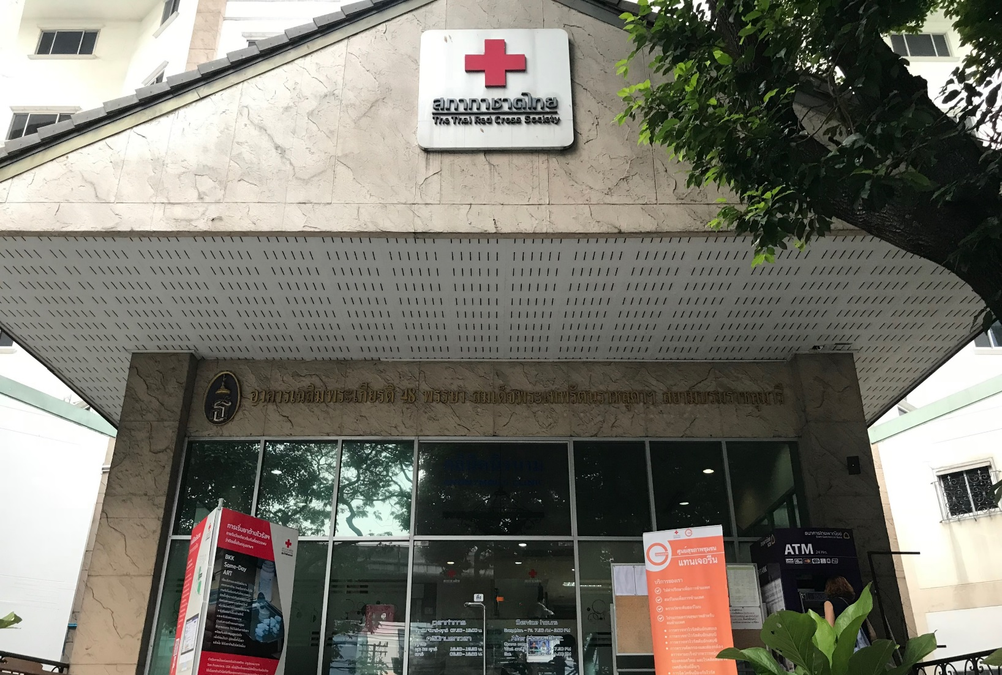
Thai Red Cross Anonymous Clinic
Large HIV and STI testing center
Provides research-based HIV and STI services
Stand-alone VCT with 150-200 HIV tests (~8% positive) per day

Slide 8
Same-Day ART Eligibility Criteria
Willing to start ART (non-coercive)
ART Naïve
Able to come back for follow-up visit(s)
Results from symptomatic screening/chest X-ray/Gene Xpert MTB/RIF not indicative of tuberculosis
Results from symptomatic screening/cryptococcal antigen test not indicative of cryptococcal meningitis
Symptomatic screening not indicative of serious opportunistic infections that would likely require hospital admissions

Slide 9

Same-Day ART Algorithm
ART drug regimen:
  FTC/TDF + EFV
Baseline tests:
  Creatinine
  Urinalysis
  CD4 count
  HBsAg
  Anti-HCV
  Syphilis serology
  ALT
  Chest X-Ray
  Cryptococcal Ag (CD<100 cells/mm³)

Slide 10
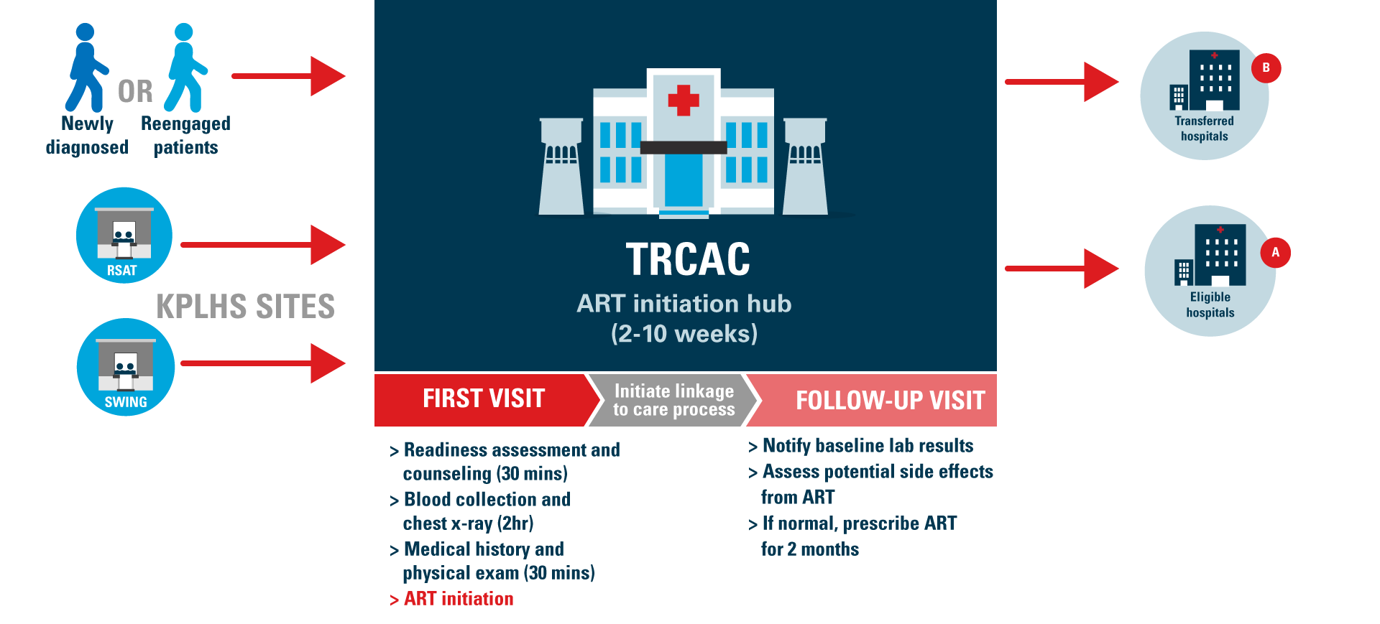
ART Initiation Hub Model at the TRC Anonymous Clinic

Slide 11
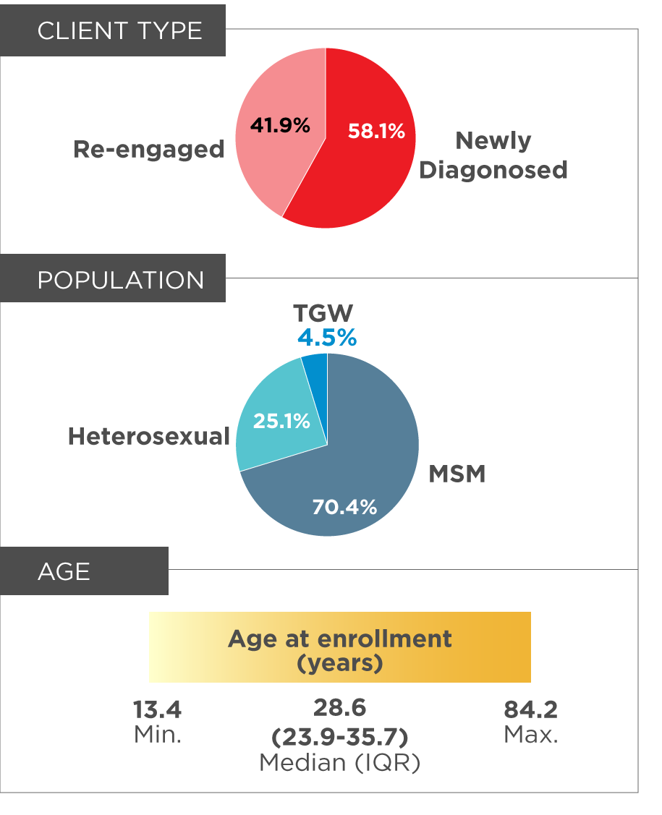
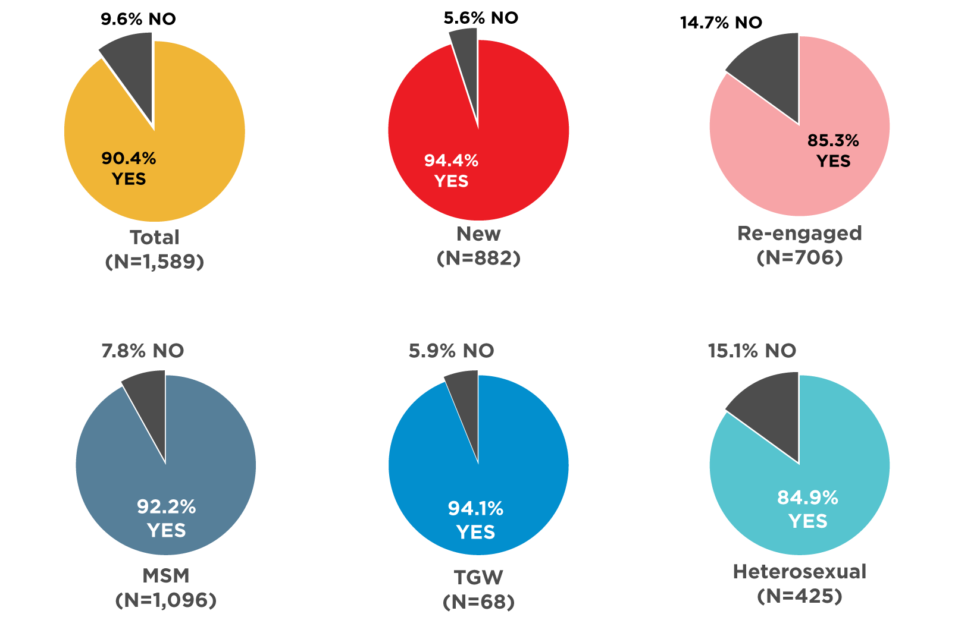
Baseline Characteristics and Acceptability
HIGH LEVELS OF ART
ACCEPTABILITY
ACCEPTABILITY
STRATIFIED BY POPULATIONS
(TRC Anonymous Clinic, Jul 2017 – April 2018, Unpublished)

Slide 12
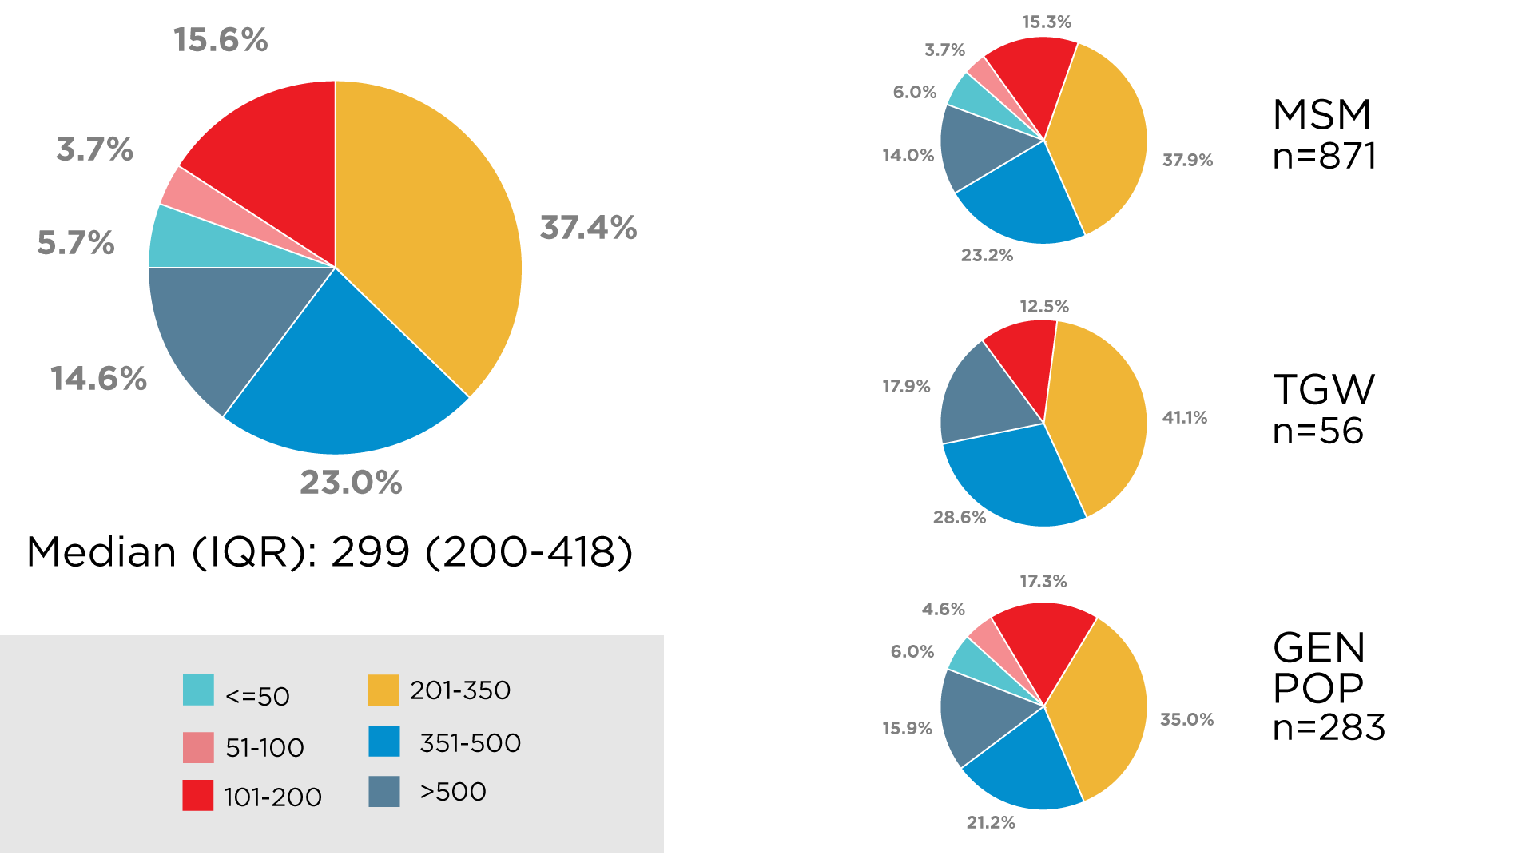
Clinical Characteristic: CD4 Level
(TRC Anonymous Clinic, Jul 2017 – April 2018, Unpublished)

Slide 13
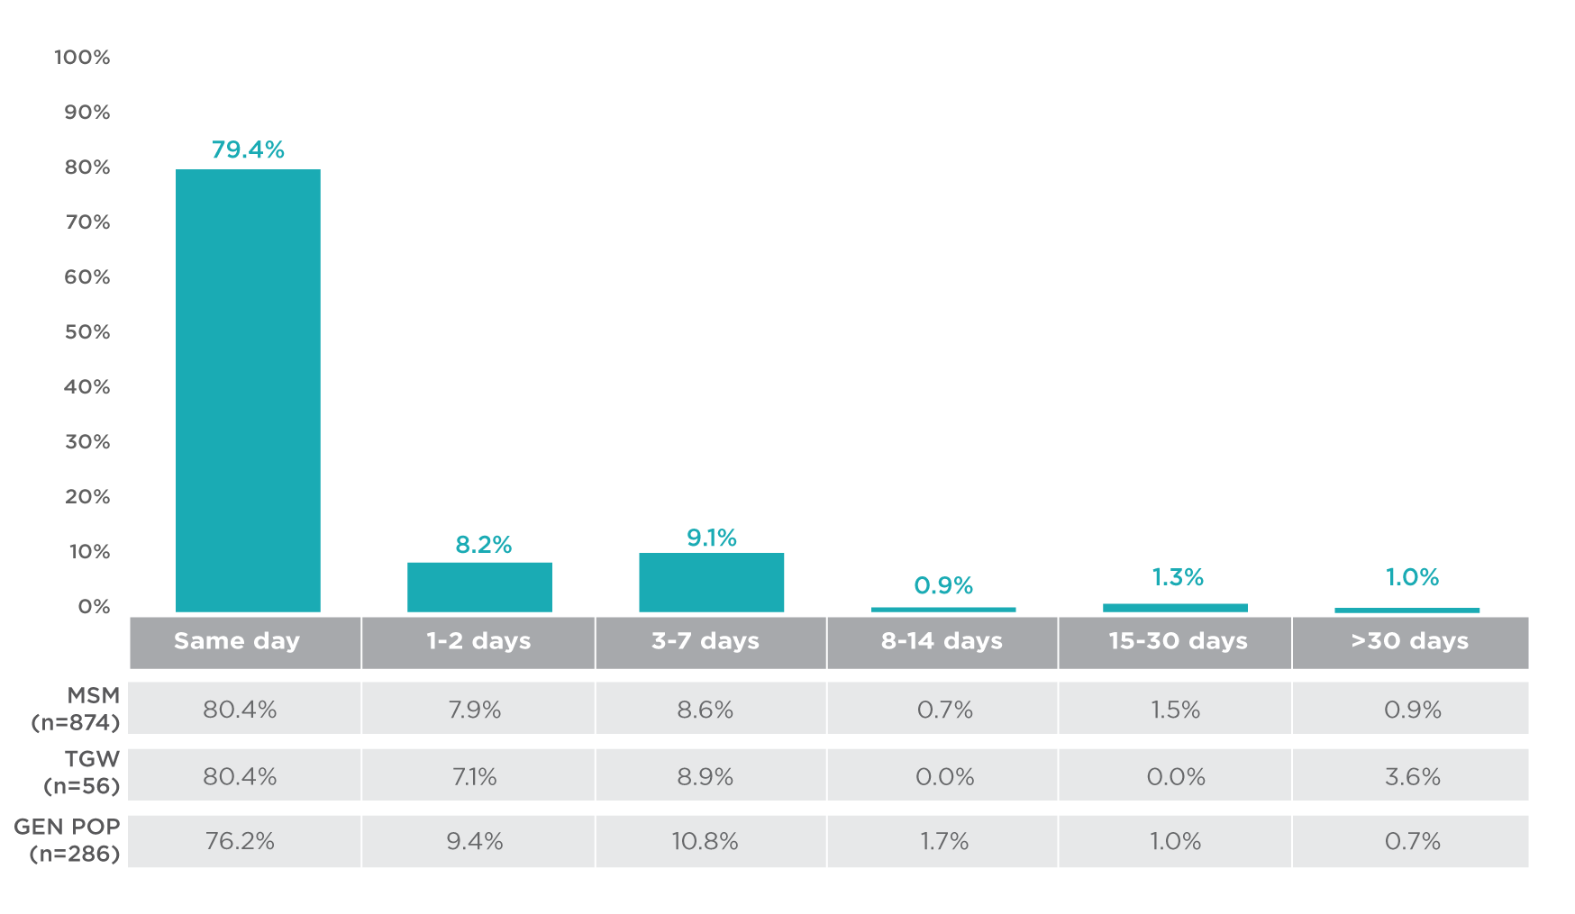
ART Initiation Time Periods
(TRC Anonymous Clinic, Jul 2017 – April 2018, Unpublished)

Slide 14
ART Uptake After HIV Diagnosis
PLHIV initiating Same-Day ART were 3.9 times more likely to start ART when compared to standard of care arm (HR: 3.9; 95%CI: 3.7-4.2; p<0.001).
(TRC Anonymous Clinic, Jul 2017 – April 2018, Unpublished)

Slide 15
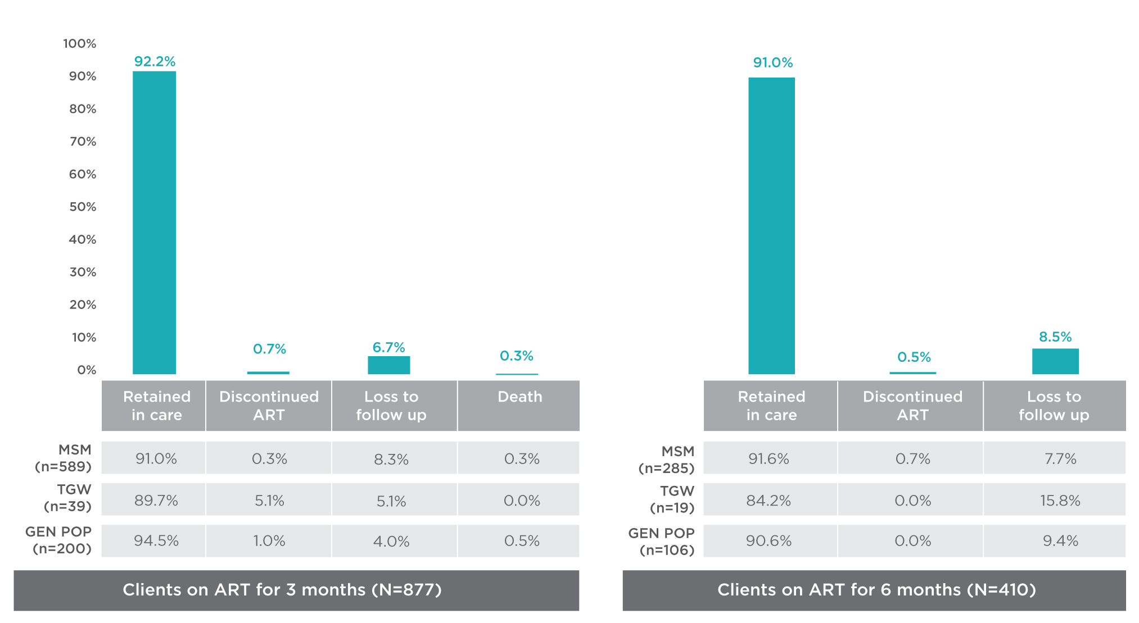
Retention-in-Care After ART Initiation
89.64% were successfully referred to long-term ART site*
  Median (days) IQR: 56 (38-70)
Among those who were not referred, 4 stopped ART (2 by physician due to ART-related side effect)
*Assessed among those who reached 75 days after ART initiation
(TRC Anonymous Clinic, Jul 2017 – April 2018, Unpublished)

Slide 16
Viral Load Suppression
93.9% of clients who received VL testing were virally suppressed
Median (days) IQR: 162.5 (130-188)
PLHIV initiating Same-Day ART were 2.2 times more likely to be virally suppressed when compared to standard of care arm (HR: 2.2; 95%CI: 1.9-2.6; p<0.001).
(TRC Anonymous Clinic, Jul 2017 – April 2018, Unpublished)

Slide 17
Challenges
Labor intensive
Essential baseline laboratories may not be available in some settings (e.g. Gene Xpert MTB/RIF, same-day CD4 result, Cryotococcal antigen test, etc.)
Concerns from healthcare professionals
  Client readiness
  Clinical safety
Long-term data depends on referred ART sites

Slide 18
What’s Next?
Scaling up to other provinces in Thailand
Need health systems that support an increase in number of PLHIV on ART (e.g. Key Population-led Differentiated Service Delivery)
More data on:
  Long-term health implications of Same-Day ART
  Qualitative assessment (quality of life, patient’s readiness, provider’s readiness, etc.)
  Cost-effectiveness

Slide 19
Acknowledgements
Persons Living with HIV
Thai Red Cross AIDS Research Centre
  Praphan Phanuphak
  Nittaya Phanuphak
  Nipat Teeratakulpisarn
  Pongsakorn Surapuchong
  Somsong Teeratakulpisarn
  Pintip Jomja
  Sorawit Amatavete
  Chotika Prabjuntuek
  Chonthicha Hanaree
  Watcha Chaison
  Prapaipan Plodgratoke
  Klayduean Singhaseni
  Ratchadaporn Meksena
  TRCARC staff
  Thai Red Cross Anonymous Clinic staff
  PREVENTION staff
UCSF
  Diane Havlir
Funding support
  Thai Red Cross AIDS Research Centre
  PEPFAR/USAID
  LINKAGES Thailand /FHI 360
Industry
  Thai Government Pharmaceutical Organization
  Janssen
  Atlanta
CBOs
  Rainbow Sky Association of Thailand
  SWING

Slide 20
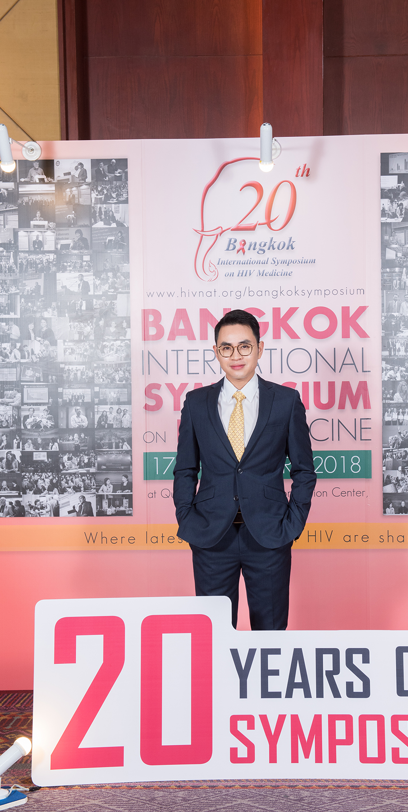
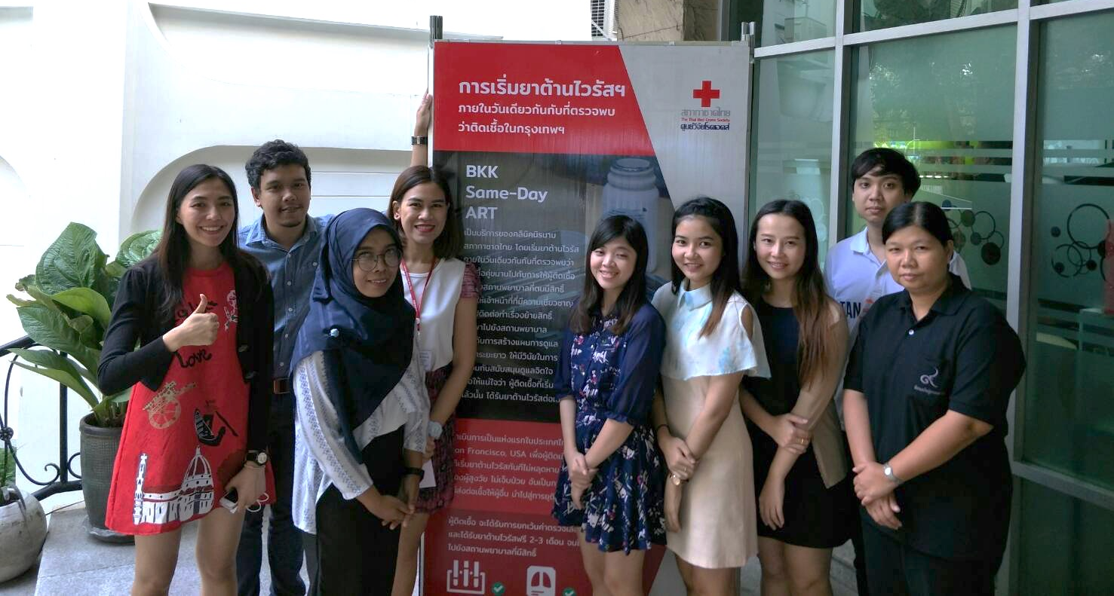
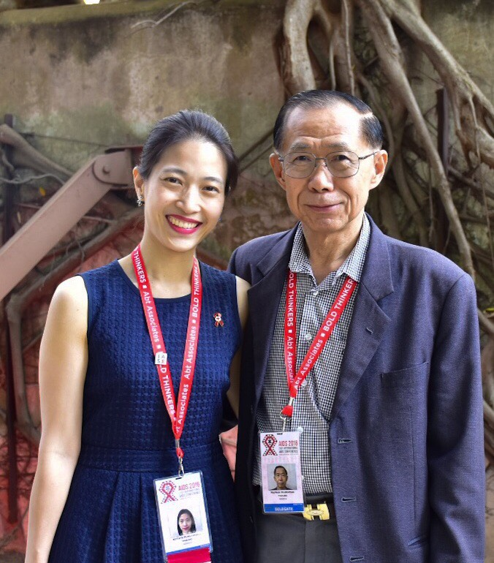
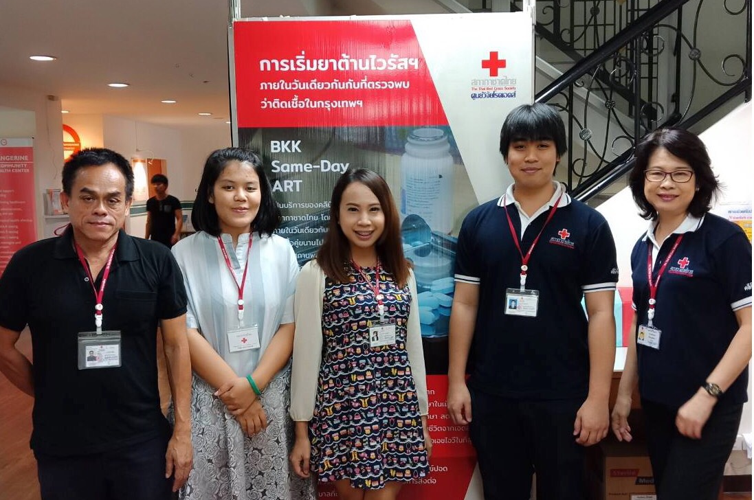
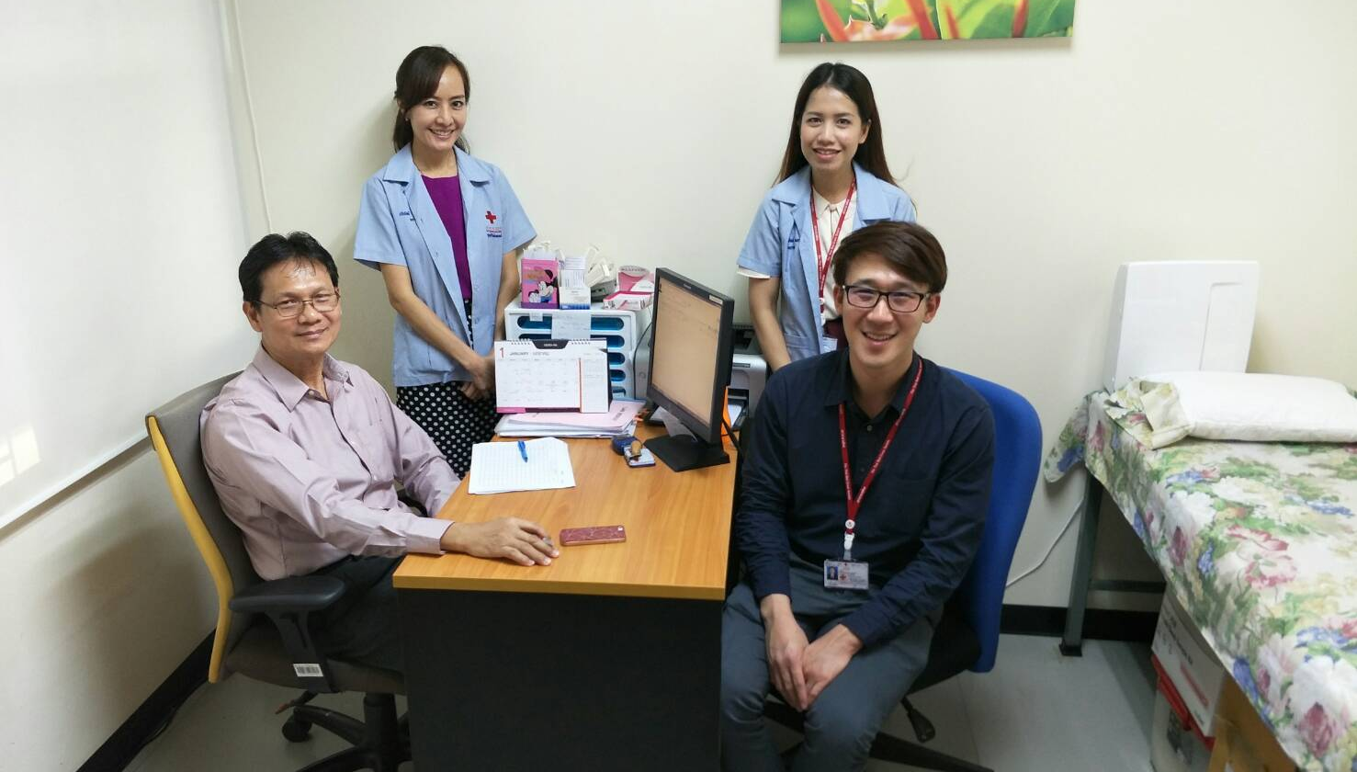
THANK YOU

